Slide 1
Topic 7 – Stacks and Queues

Slide 2
Abstract Data Types (ADTs)
Stacks and queues are abstract data types – they are more conceptual in nature than concrete data types such as arrays
The ideas of stacks and queues is described by their interface – we’re not interested in how they’re actually implemented
Underlying mechanism is typically not visible to the user – we just want to know how to use them

Slide 3
Stacks

Slide 4
Stack Interface
There are several things you can do with a stack
Pop ( ) – pop the top item off the stack
Push ( ) – put another item onto the top
Peek ( ) – look at the top item and copy it
The stack mechanism is known as Last-In-First-Out (LIFO) because the last item inserted is the first one removed
Stacks are also referred to as
pushdown stack
pushdown list

Slide 5
Push
push ( element )
insert an element at the top of the stack
push
NEW
NEW
top
3
3
top
2
2
1
1
0
0

Slide 6
Pop
pop ( )
remove an element from the top of the stack
pop
4
4
top
3
3
top
2
2
1
1
0
0

Slide 7
Peek
Peek ( )
look at the top item and copy it
peek
4
4
4
top
top
3
3
copy
2
2
1
1
0
0

Slide 8
Other Stack Operations
MakeEmpty( )
Remove all items from the stack
IsEmpty( )
True if stack is empty, false otherwise
IsFull( )
True if stack is full, false otherwise

Slide 9
Array-based Stack
A simple way of implementing the Stack ADT uses an array
We add elements from left to right
A variable keeps track of the index of the top element

Slide 10
Push and Pop
Empty stack
push(10)
push(4)
pop(10)
top
4
top
10
10
top
10
top
top = -1
top = 0
top = 1
top = 0

Slide 11
Array-based Stack (cont.)
The array storing the stack elements may become full
A push operation will then throw a FullStackException
Limitation of the array-based implementation
Not intrinsic to the Stack ADT

Slide 12
Implementing a Stack
Stack object will need several instance fields
maxSize to store the size of the array
an array of numbers stackArray to store the stack
a variable called top to track where the top of the stack is
Constructor will take in size of array, initialize it and set top to -1 since there’s nothing in the stack to start with

Slide 13
Java Implementation
public class Stack {
private int maxSize; // size of stack array
private long[] stackArray;
private int top; // top of stack
public Stack(int s) { // constructor
maxSize = s; // set array size
stackArray = new long[maxSize]; // create array
top = -1; // no items yet
}
}

Slide 14
Methods
public void push(long j) { // put item on top of stack
top++;
stackArray[top] = j; // increment top, insert item
}
push
NEW
NEW
top
3
3
top
2
2
1
1
0
0

Slide 15
Methods
public long pop() { // take item from top of stack
return stackArray[top--]; //access item, decrement top
}
Note.
top-- and top++: assignment first and then operation
--top and ++top: operation first and then assignment
pop
4
4
top
3
3
top
2
2
1
1
0
0

Slide 16
Methods
public long peek() { // peek at top of stack
return stackArray[top];
}
peek
4
4
4
top
top
3
3
copy
2
2
1
1
0
0

Slide 17
Methods
public boolean isEmpty() { // true if stack is empty
return (top == -1);
}
public boolean isFull() { // true if stack is full
return (top == maxSize - 1);
}
public void makeEmpty() { // empty stack
top = -1;
}
// We just need to reset the index of top as -1.

Slide 18
Result
Stack theStack = new Stack(10); // make new stack
theStack.push(20); // push items onto stack
theStack.push(40); theStack.push(60);
theStack.push(80); while (!theStack.isEmpty()){
System.out.println(theStack.pop()); }
while (!theStack.isEmpty()){
System.out.println(theStack.pop());
}
Output would be :
===============
80
60
40
20

Slide 19
Stack Structures
In which of the following situations could you feasibly use a stack?
Storing fruit
Storing milk cartons
Storing cans
Can you think of anything else using a stack structure?
Web browsers
Undo sequence in a text editor
Java Virtual Machine

Slide 20
Method Stack in the JVM
The Java Virtual Machine (JVM) keeps track of the chain of active methods with a stack
When a method is called, the JVM pushes on the stack a frame containing
Local variables and return value
Program counter, keeping track of the statement being executed
When a method ends, its frame is popped from the stack and control is passed to the method on top of the stack

Slide 21
Method Stack in the JVM
main() {
int i = 5;
foo(i);
}
foo(int j) {
int k;
k = j+1;
bar(k);
}
bar(int m) {
…
}
Finally.
============
main
i = 5
foo
j = 5
k = 6
bar
m = 6

Slide 22
What can we use stacks for?
The LIFO principle can be used in reversing a word
If we push “h”, “e”, “l”, “l”, “o” and then pop the contents of the stack
Output is “o”, “l”, “l”, “e”, “h”

Slide 23
Checking for palindromes
The LIFO principle can be used to check if a word is a palindrome
Say we have a word like redder
Push the the word onto the stack
Pop it off the stack
It has now been reversed – check if it is the same as the original
r
e
d
d
e
r

Slide 24
Parentheses Matching
Each “(”, “{”, or “[” must be paired with a matching “)”, “}”, or “[”
correct: ( )(( )){([( )])}
correct: ((( ))(( )){([( )])})
incorrect: )(( )){([( )])}
incorrect: ({[ ])}
incorrect: (
Start from the beginning of the sequence
Opening brackets are placed on a stack
When the program comes across a closing bracket it pops from the ‘opening bracket stack’ and this should match
When the program comes to the end, the ‘opening bracket stack’ must be empty

Slide 25
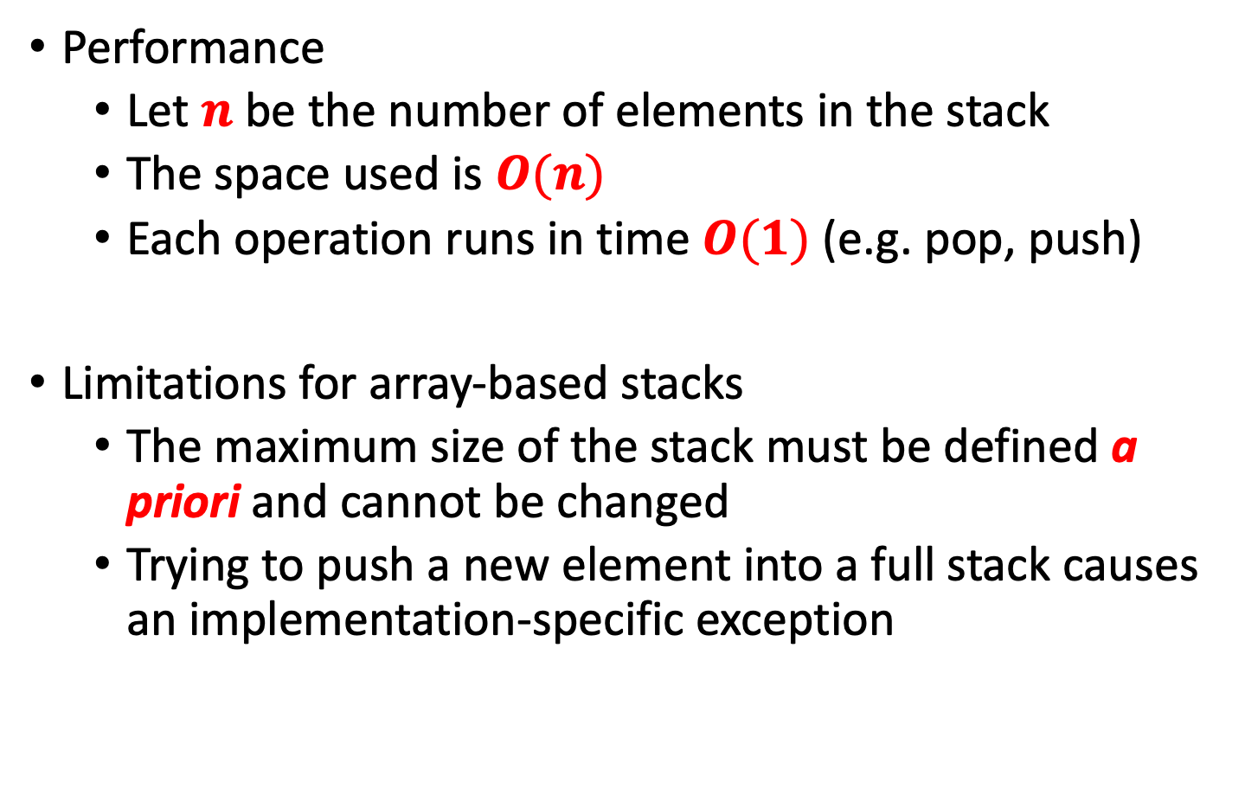
Performance and Limitations
Performance
Let $n$ be the number of elements in the stack
The space used is $O(n)$
Each operation runs in time $O(1)$ (e.g. pop, push)
Limitations for array-based stacks
The maximum size of the stack must be defined a priori and cannot be changed
Trying to push a new element into a full stack causes an implementation-specific exception

Slide 26
Queues
A queue means to line up for something

Slide 27
Queues
Queues use the First-In-First-Out system (FIFO)
Rather than piling items up, the one that has been in the queue the longest is the one that is popped
Insertions are made at one end, the back of the queue
Deletions take place at the other end, the front of the queue
So, the last one added is always the last one available for deletion

Slide 28
Queues
Queues are used everywhere e.g. printer queue, multitasking
Push ( ) is called insert, put, add or enqueue!
Pop ( ) is called remove, delete, get or dequeue!
The front and back of the queue are called the front and rear
front
rear

Slide 29
Insert
insert ( ) method
Assumes the queue is not full
Inserts at rear
If rear is at the top of the array then it wraps around to the bottom of the array
front
rear
front
rear
insert ( )

Slide 30
Remove
remove ( ) method
Assumes queue is not empty
Obtains the value at the front
Increments the front variable
If front goes beyond the end of the array it must be wrapped around to 0
front
rear
front
rear

Slide 31
Other Methods
peek ( )
Returns the value at the front
size ( )
Assumes queue not empty
Returns total number in queue
isFull ( )
Returns true if queue is full
isEmpty ( )
Returns true if queue is empty

Slide 32
Variables
We need to maintain some variables with our queue class
Size of the array
The array itself
Variables for tracking front and rear
Empty Queue:
Front = 0, Rear = -1
3 items in queue:
Front = 0, Rear = 2

Slide 33
Examples
Empty
Queue
Remove
2 Elements
Insert
2 Elements
3 Elements
e
4
4
4
4
d
3
3
3
3
c
c
c
2
2
2
2
b
1
1
1
1
a
0
0
0
0
front: 0
rear: -1
front: 0
rear: 2
front: 2
rear: 2
front: 2
rear: 2

Slide 34
Examples
We implement wrapround
when either back or front reach the end of the array, we reset it to the beginning.
To insert element f, we reset back to the start of the array and place f there
rear = (4+1) % 5
Insert
2 Elements
Insert
Element f
e
e
4
4
d
d
3
3
c
c
2
2
1
1
f
0
0
front: 2
rear: 2
front: 2
rear: 0

Slide 35
Array-based Queue
Use an array of size N in a circular fashion
Two variables keep track of the front and rear
front index of the front element
rear index of the last element

Slide 36
Queue Class
public class Queue {
private int maxSize;
private long[] queArray;
private int front;
private int rear;
private int nItems;
public Queue(int s) { // constructor
maxSize = s;
queArray = new long[maxSize];
front = 0;
rear = -1;
nItems = 0;
}

Slide 37
Method of Insert
public boolean insert(long j) { // put item at rear of queue
if(isFull())
return false; //don’t insert if full
if(rear == maxSize-1) // deal with wraparound
rear = -1;
rear++;
queArray[rear] = j; // increment rear and insert
nItems++; // one more item
return true; //successfully inserted
}

Slide 38
Method of Remove
public long remove() { // take item from front of queue
if(isEmpty())
return null; //don’t remove if empty
long temp = queArray[front];// get value and incr front
front++;
if(front == maxSize) // deal with wraparound
front = 0;
nItems--; // one less item
return temp;
}

Slide 39
Method of peekFront and check empty
public long peekFront() { // peek at front of queue
return queArray[front];
}
public boolean isEmpty() { // true if queue is empty
return (nItems==0);
}

Slide 40
Mothod of check Full and return its size
public boolean isFull() { // true if queue is full
return (nItems==maxSize);
}
public int size() { // number of items in queue
return nItems;
}

Slide 41
Queue Example
Operation | Output | front ⬅ Q ⬅ rear
insert(5) | – | (5)
insert(3) | – | (5, 3)
remove() | 5 | (3)
insert(7) | – | (3, 7)
remove() | 3 | (7)
front() | 7 | (7)
remove() | 7 | ()
remove() | “error” | ()
isEmpty() | true | ()
insert(9) | – | (9)
insert(7) | – | (9, 7)
size() | 2 | (9, 7)
insert(3) | – | (9, 7, 3)
insert(5) | – | (9, 7, 3, 5)
remove() | – | (7, 3, 5)

Slide 42
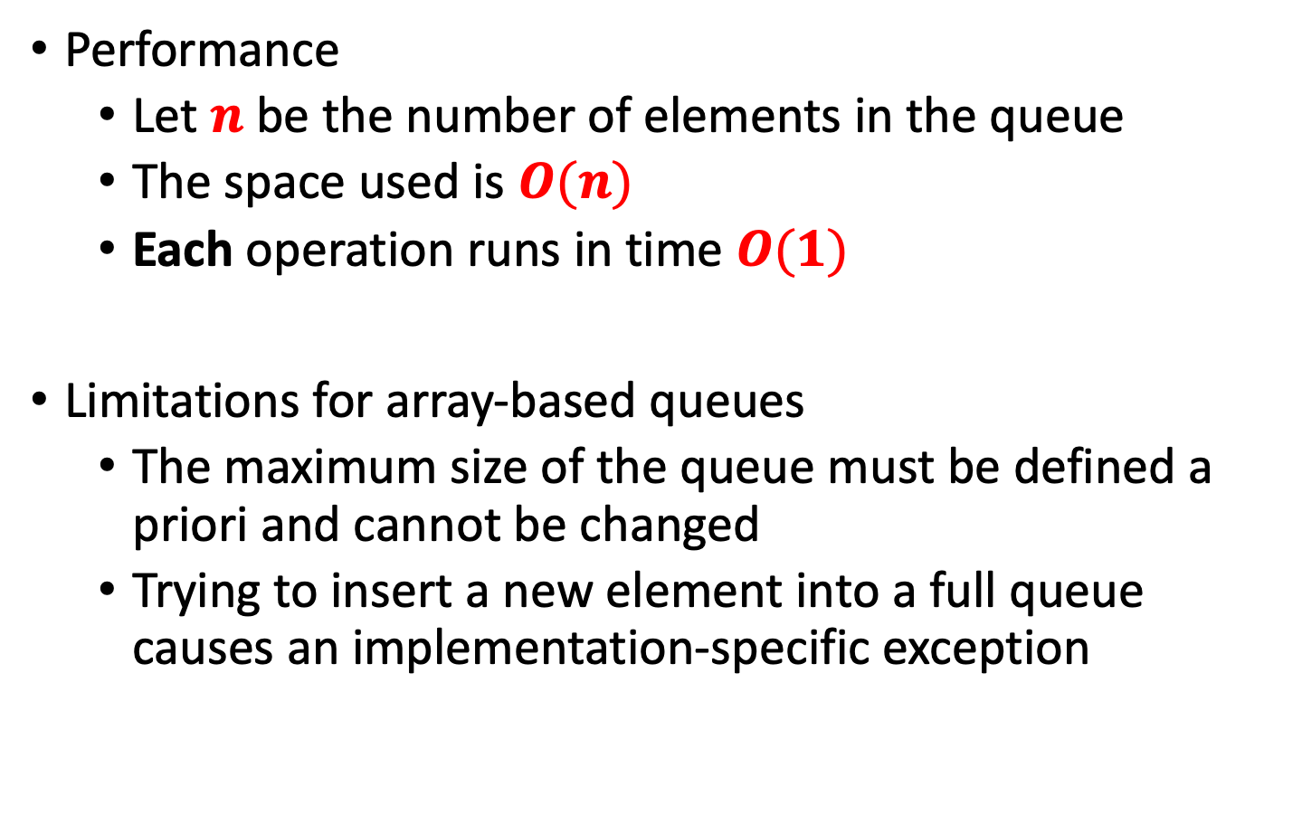
Performance and Limitations
Performance
Let $n$ be the number of elements in the queue
The space used is $O(n)$
Each operation runs in time $O(1)$
Limitations for array-based queues
The maximum size of the queue must be defined a priori and cannot be changed
Trying to insert a new element into a full queue causes an implementation-specific exception

Slide 43
Deque
A deque is a double-ended queue
This means you can insert items at either end and delete them at either end
Essentially, there is no longer a front and rear, simply two ends
Use methods called
insertLeft( )
insertRight( )
removeLeft( )
removeRight( )

Slide 44
insertLeft( ) and insertRight( )
insertLeft( )
insertRight( )
left
right
left
right
insertLeft()
left
right
left
right
insertRight()

Slide 45
removeLeft() and removeRight()
removeLeft()
removeRight()
1
2
3
4
2
3
4
left
right
left
right
1
2
3
4
1
2
3
left
right
left
right

Slide 46
Deques, Stacks and Queues
A stack is actually a deque with only the methods
insertRight( )
removeRight( )
A queue is a deque with only the methods
insertRight( )
removeLeft( )
A deque is actually a more versatile data structure than either a stack or a queue but is not used as often

Slide 47
Priority Queue
A priority queue is a queue where items don’t just join at the rear, they are slotted into the queue according to their priority
Imagine a stack of mail which are sorted according to priority
Each time a new letter is added, you slot it in according to its priority
Every time you pick up a letter to read, you are picking the most important one of the pile

Slide 48
What’s Different?
Don’t really need to track front and rear as the rear always stays put at slot 0
It looks kind of similar to a stack because we only need to track the top - would be better named as a “priority stack”
We shift elements up to make space rather than just putting the element at the rear
Insert method has a for loop that shifts elements up
Remove method simply removes the top (highest priority) element

Slide 49
Priority Queue Insert ( )
public void insert(long item) { // insert item
if(nItems == 0){ // if no items,
queArray[0] = item; // insert at 0
}
else{ // if some items,
int j = nItems; // start at end
while(j > 0 && queArray[j-1] > item){ // while new item larger
queArray[j] = queArray[j-1]; // shift upward
j--; // decrement j
}
queArray[j] = item; // insert it
}
nItems++; // increase items
}

Slide 50
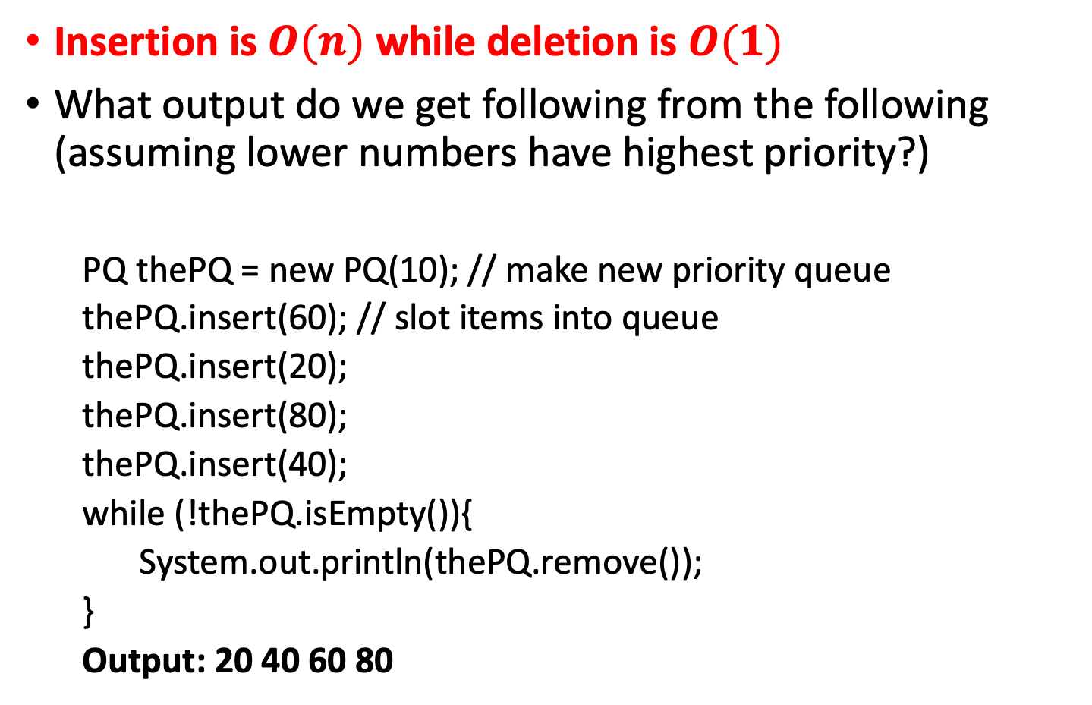
Priority Queue
Insertion is $O(n)$ while deletion is $O(1)$
What output do we get following from the following (assuming lower numbers have highest priority?)
PQ thePQ = new PQ(10); // make new priority queue
thePQ.insert(60); // slot items into queue
thePQ.insert(20);
thePQ.insert(80);
thePQ.insert(40);
while (!thePQ.isEmpty()){
System.out.println(thePQ.remove());
}
Output: 20 40 60 80

